Slide 1
RNN

Slide 2
Recurrent Neural Networks
A Recurrent Neural Network is a kind of neural network created by applying the same set of weights recurrently over a time-varying input, to produce a time-varying output over variable-length input structures.
x₀
RNN
y₀
x₁
y₁
x₂
y₂
state
x₃
y₃

Slide 3
Recurrent Neural Networks: how to build a simple one
Input sequence:
x₀
x₁
x₂
x₃
RNN
x₀
MLP
x₁
x₂
x₃
task
0

Slide 4
Recurrent Neural Networks: Applications
Recurrent Neural Networks (RNNs) find applications in various fields, leveraging their ability to process time-varying data. The key applications can be diveded into two major families:
Sequence to Task
Sequence-to-task models process sequential input data and accomplish specific tasks, such as classification or regression, by capturing temporal dependencies and patterns within the sequence.
Sequence to Sequence
Sequence-to-sequence (seq2seq) models are designed to handle input and output sequences of varying lengths. Seq2seq models are applied in machine translation, text summarization, speech-to-text conversion, etc...

Slide 5
Recurrent Neural Networks: Computational Graph (end loss)
x₁
x₂
x₀
RNN
RNN
RNN
0
MLP
RNN parameters
MLP parameters
loss

Slide 6
Recurrent Neural Networks: Computational Graph (step loss)
MLP parameters
loss
MLP
loss
MLP
loss
MLP
x₁
x₂
x₀
RNN
RNN
RNN
0
RNN parameters

Slide 7
PyTorch: Concat and Stack
In PyTorch, concat and stack are functions used for combining tensors along different dimensions.
Concatenation (torch.concat):
This function is used to concatenate tensors along a specified dimension. For example, if you have two tensors A and B with the same size along all dimensions except for a specific dimension, you can concatenate them along that dimension using torch.cat([A, B], dim).
Stacking (torch.stack):
Stacking is similar to concatenation but creates a new dimension for the stacked tensors. If you have two tensors A and B, stacking them with torch.stack([A, B], dim) will create a new dimension along the specified dimension and stack them along that.

Slide 8
PyTorch: Concat and Stack
1
1
1
3
3
3
2
2
2
4
4
4
A
B
1
1
1
3
3
3
2
2
2
1
1
1
3
3
3
1
1
1
4
4
4
3
3
3
2
2
2
4
4
4
2
2
2
4
4
4
torch.concat((A, B), dim=0)
torch.concat((A, B), dim=1)
torch.stack((A, B), dim=0)

Slide 9
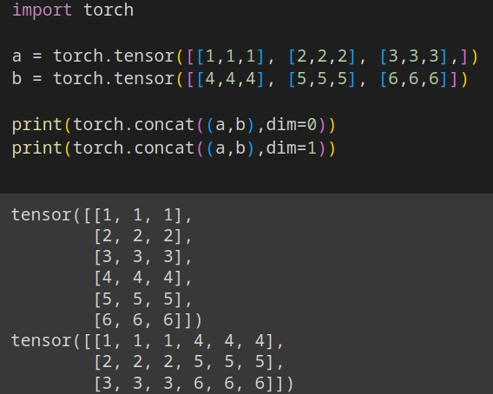
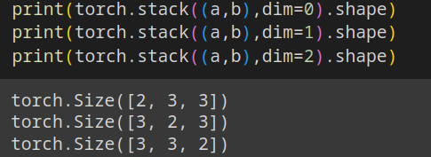
PyTorch: Concat and Stack

Slide 10
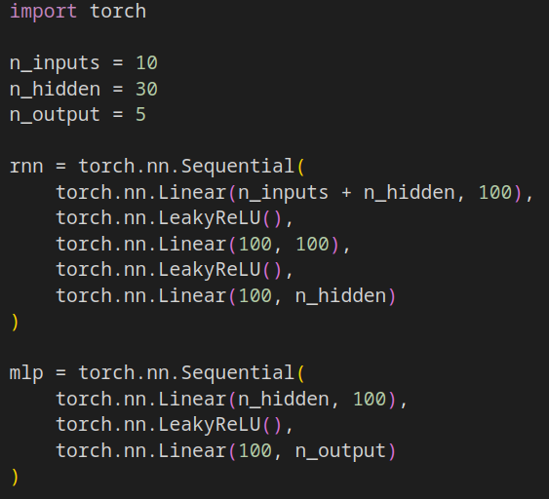
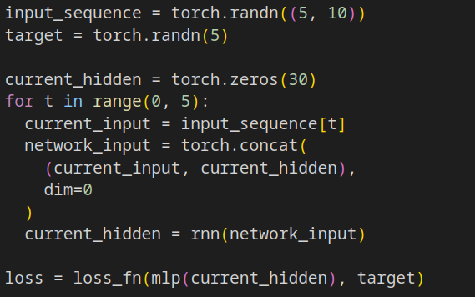
Simple RNN in PyTorch (end loss)

Slide 11
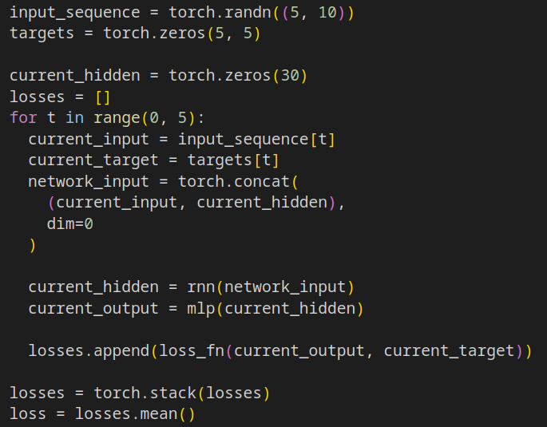
Simple RNN in PyTorch (step loss)

Slide 12
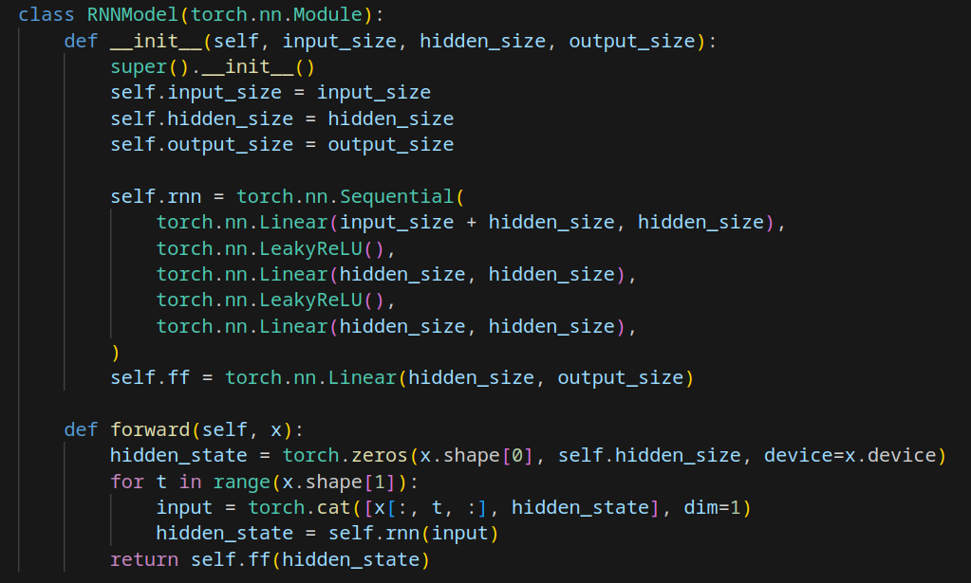
Simple batched RNN in PyTorch (out on last state)

Slide 13
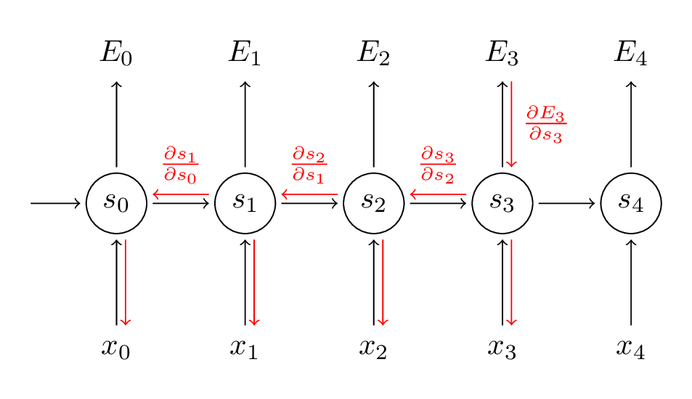
Vanishing gradient problem in RNNs
RNNs are prone to the vanishing gradient problem, hindering their ability to learn from long sequences.
This occurs when gradients become extremely small during backpropagation through time, especially in long sequences.
Factors like repeated application of weight matrices, certain activation functions, and poor initialization contribute to this issue.

Slide 14
Vanishing gradient problem mitigation
The vanishing gradient problem in RNN can be mitigated but cannot be completely solved.
There are several architectures that tries to mitigate it by selectively retain and forget information during sequential processing.
In the next slides we will delve deeper into:
Long-Short Term Memory (LSTM) networks
Gated Recurrent Unit (GRU) networks

Slide 15
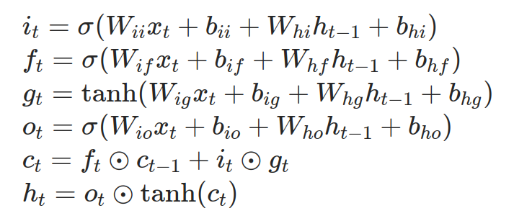
Long-Short Term Memory (LSTM)
Long Short-Term Memory (LSTM) is a type of recurrent neural network (RNN) architecture designed to address the vanishing gradient problem.
LSTMs introduce a memory cell with a gating mechanism, allowing it to selectively store, read, and erase information over time.
input gate
forget gate
cell gate
output gate
next memory
next hidden

Slide 16
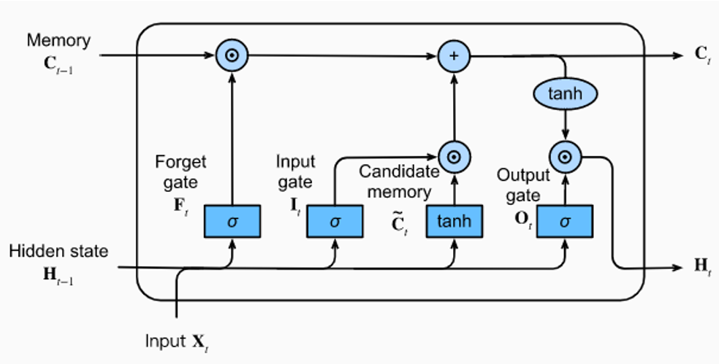
Long-Short Term Memory (LSTM)

Slide 17
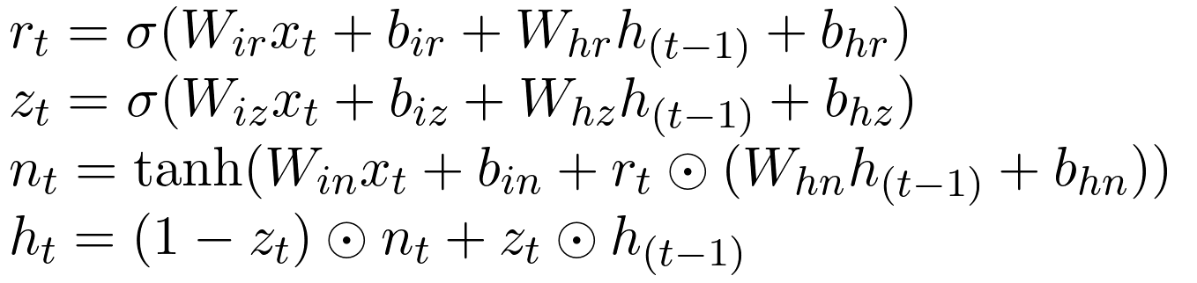
Gate Recurrent Unit (GRU)
The Gated Recurrent Unit (GRU) is also a type of recurrent neural network (RNN) architecture designed to address the vanishing gradient problem.
Similar to Long Short-Term Memory (LSTM), GRUs utilize gating mechanisms, but they have a simpler structure with three gates: the reset gate, the update gate and the new gate.
reset gate
update gate
new gate
next hidden

Slide 18
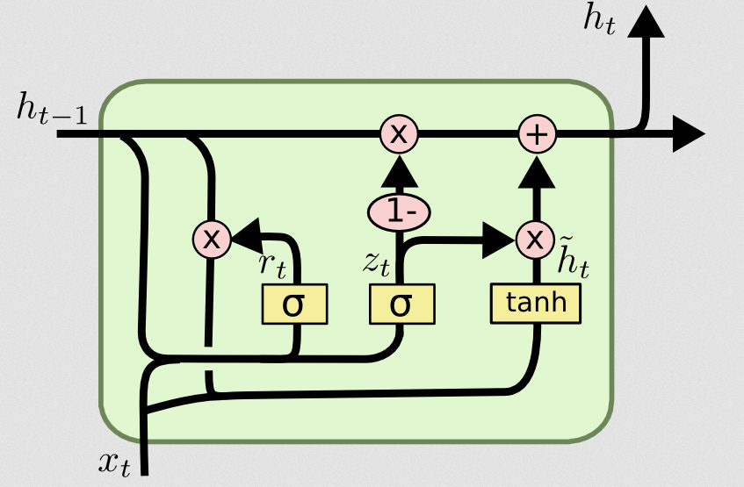
Gate Recurrent Unit (GRU)

Slide 19
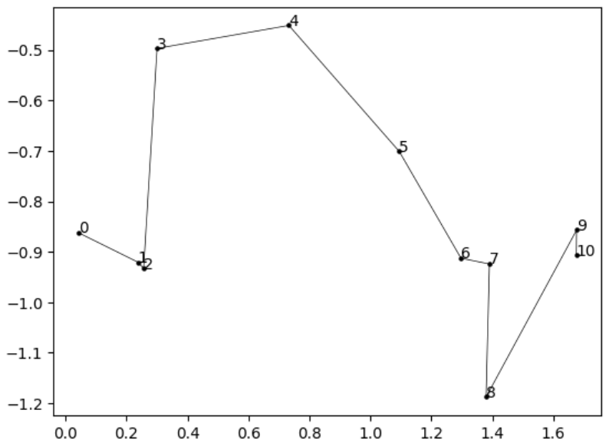
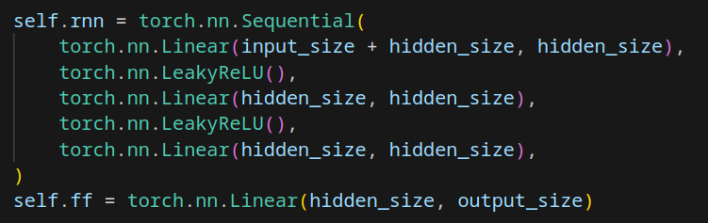
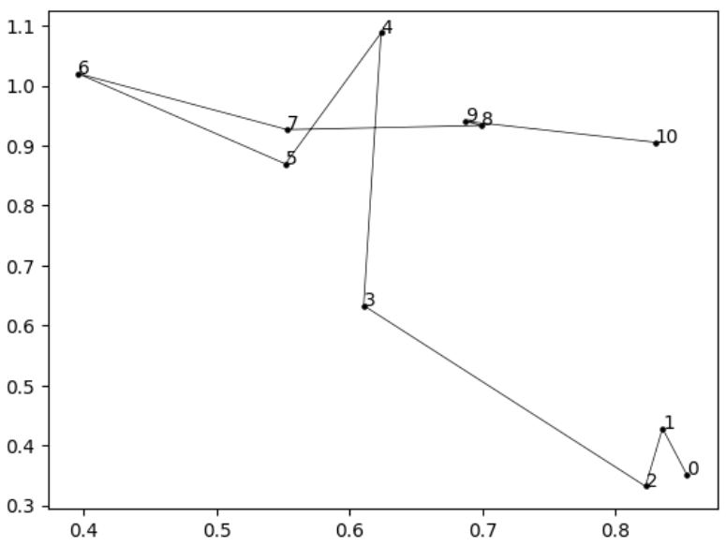
Exercise 1: RNN on custom dataset
Train this RNN to solve the sequence classification problem

Slide 20
Exercise 2: LSTM on custom dataset
Train a LSTM to solve the same sequence classification problem

Slide 21
Exercise 3: Compare RNN LSTM and GRU on custom dataset
Compare a RNN, LSTM and GRU on the same dataset
All the recurrent networks should have:
300 hidden neurons
3 layers
The final classification task should be solved using a single linear layer 300 => 2
Use same epochs, batch size and learning rate

